Slide 1
Web-page Summarization (Semantics Driven)
Lakshmi Narayana Podagatlapalli
Veera Lohith Madhuvarasu

Slide 2

Motivation
Internet is used on devices that depend on screen.
Despite technologies like screen reader, the usability of the web pages is low for the blind.
Even simple tasks take huge amounts of time.
According to a study[1], the guidelines published by the World Wide Web Consortium for web accessibility cover only 50.4% of the challenges faced the blind in browsing.
This work helps by giving an overview of the web page.

Slide 3
Overview
Three main parts:
Web page segmentation.
Summarization of the extracted segments.
Implementation

Slide 4
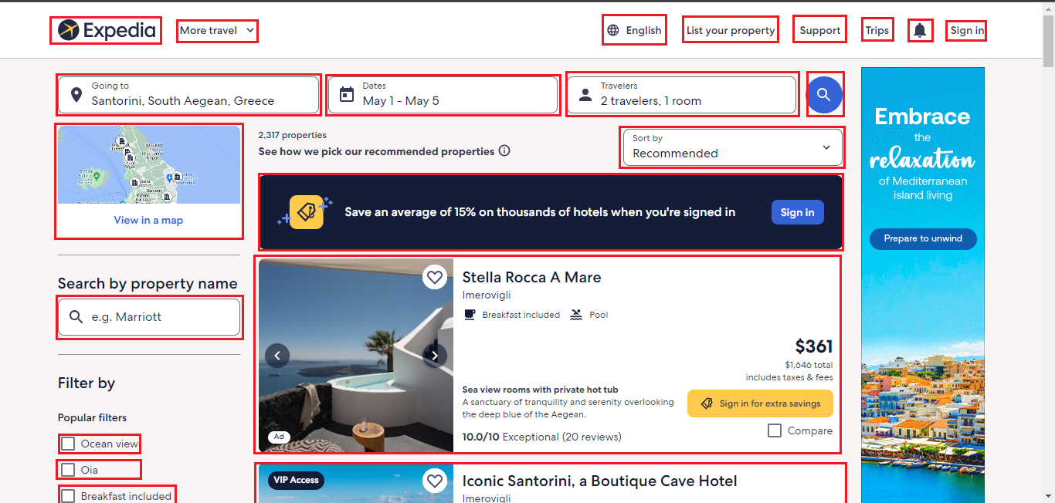
Web Page Segmentation
Extract the important objects on a web page and identify their purpose.

Slide 5
Web Page Segmentation - 2
Several types of algorithms exist.
Based on the work by Ferdous et al[2].
We chose to use Machine Learning – classification.

Slide 6
Web Page Segmentation - 3
Select objects to focus on.
For each object, features are selected.
These features are used to train a machine learning classification algorithm.
The objects are identified and extracted from a new page.

Slide 7
Summarization
Condensing a piece of information into a smaller one.
Conventional summarization is of 4 types:
Extractive Summarization – select the parts that carry most meaning.
Abstractive Summarization – created with material not present in the document.
Indicative Summarization – give a glimpse of what to expect.
Informative Summarization – replace information with a shorter version.

Slide 8
Summarization - 2
Summarization in this work is unconventional.
Focus is on the semantic layout of a web page instead of the content.
Summarization is applied on objects.
Objects on the web page performing a certain task are identified to get a high-level view.

Slide 9
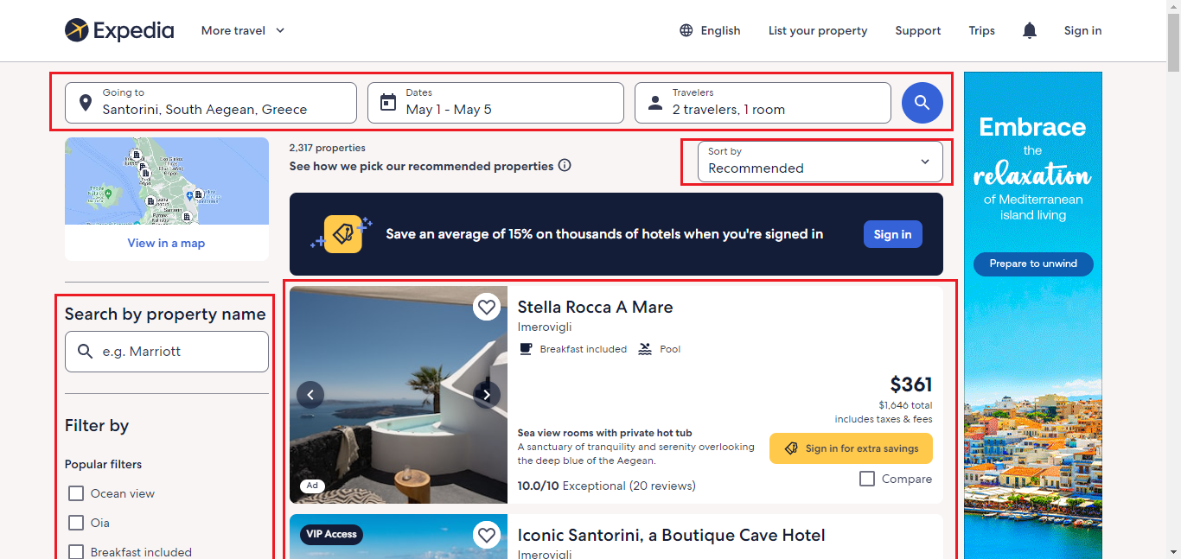
Summarization - 3

Slide 10
Speech
The output from the summarization part is converted to speech.
Used GTTS (Google Text to Speech) API.
Used PyGame library for audio output.

Slide 11
Implementation
Implemented through a chrome extension.
Flask for backend

Slide 12
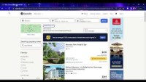
Output

Slide 13
References
Christopher Power, André Freire, Helen Petrie, and David Swallow. 2012. Guidelines are only half of the story: accessibility problems encountered by blind users on the web. In Proceedings of the SIGCHI conference on human factors in computing systems. 433–442.
Javedul Ferdous, Hae-Na Lee, Sampath Jayarathna, and Vikas Ashok. 2022. InSupport: Proxy Interface for Enabling Efficient Non-Visual Interaction with Web Data Records. In 27th International Conference on Intelligent User Interfaces. 49–62.

Slide 14
The End

